Slide 1
Using Neural Networks to model a realistic ‘Park-the-Bus’ defensive football team
By Liam Keown and Harry Tabb
Notes:
The main aim of the project was to create a machine learning model to predict defensive positions from the positions of the attacking players and the ball in short park the bus style phases of play .
park the bus is a defensive strategy that aims to sit all defending players deep to reduce space in dangerous areas. This is normally played by low calibre teams against top teams when they know they cant compete on the ball. Therefore, they look to absorb pressure and hit on the counter attack.

Slide 2
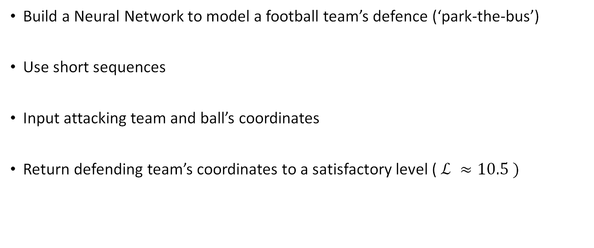
Project Goals
Build a Neural Network to model a football team’s defence (‘park-the-bus’)
Use short sequences
Input attacking team and ball’s coordinates
Return defending team’s coordinates to a satisfactory level ( $ℒ ≈10.5 )$
Notes:
Justify why short sequence

Slide 3
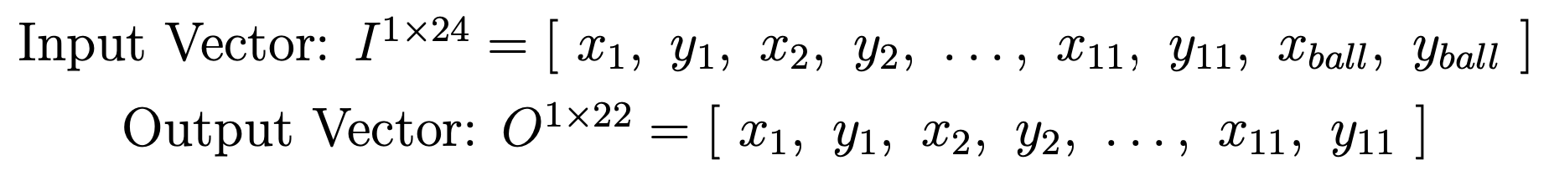
Project Method
Sequences of 45 frames (9 seconds)
1-dimensional vector frames:
Notes:
Mention using LSTM

Slide 4
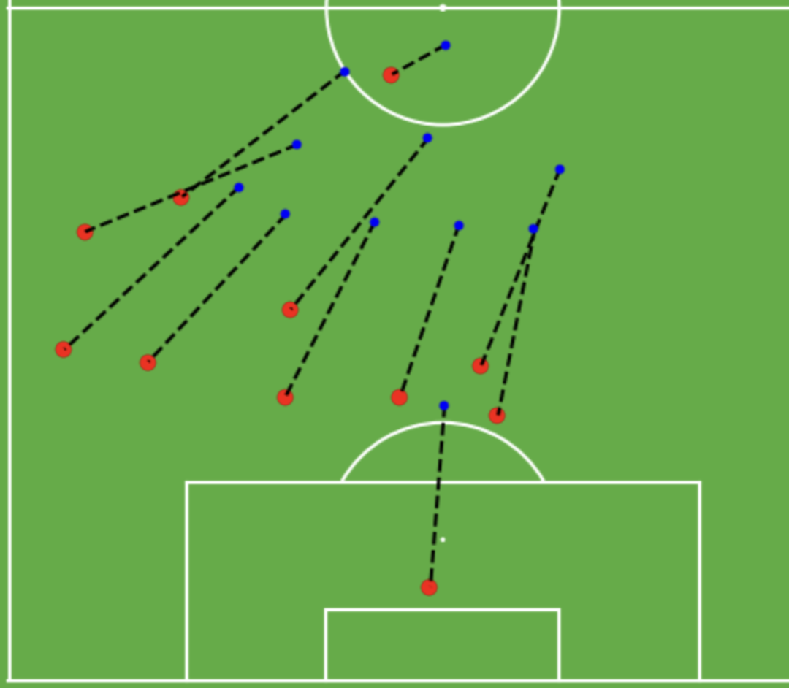
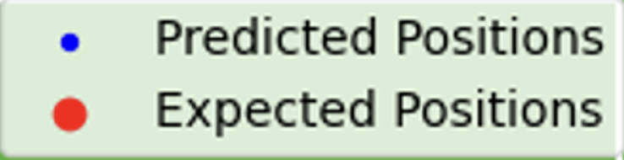
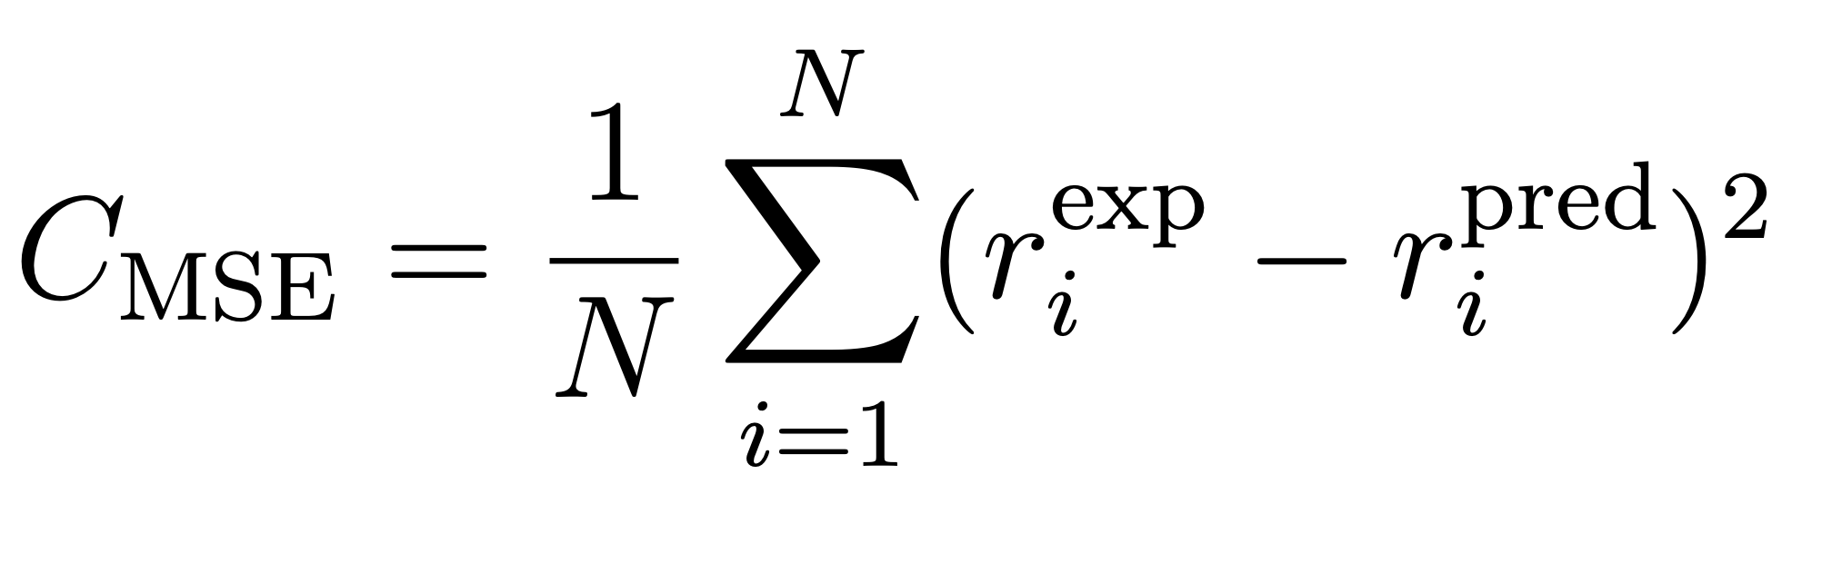
Cost Function
Notes:
Justify why short sequence

Slide 5
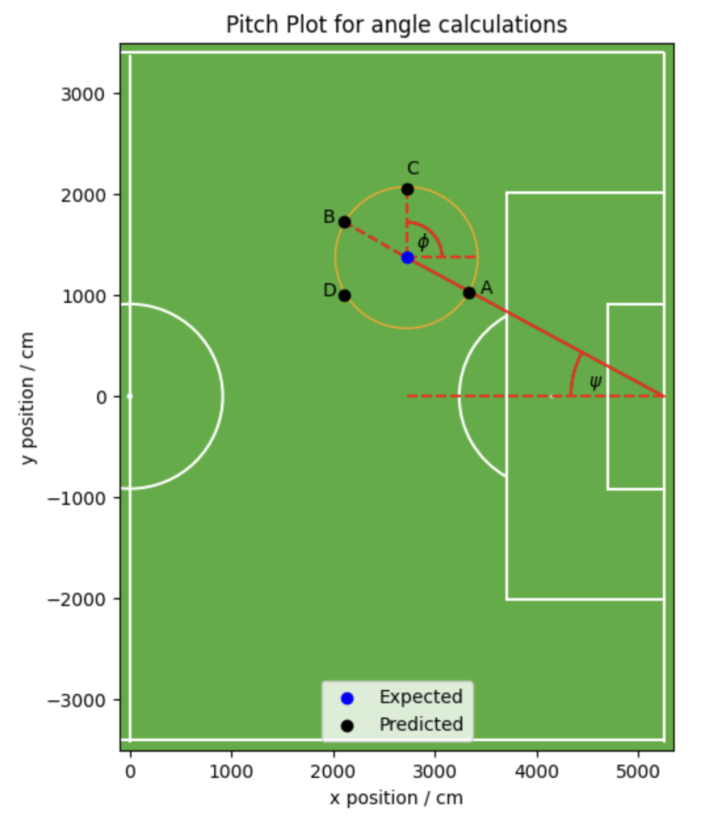

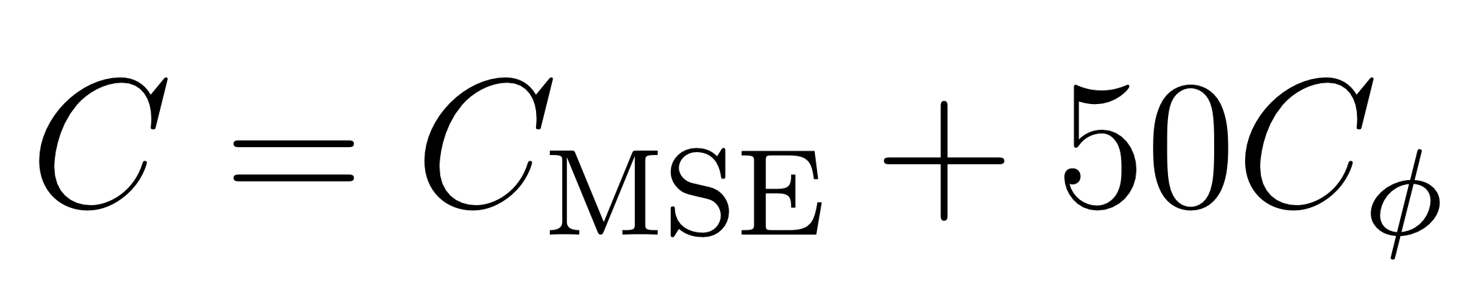
Cost Function

Slide 6
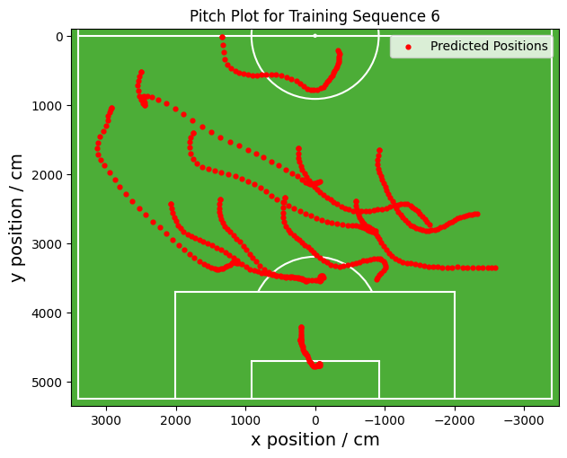
The Dataset
Included every team with below 45% possession between 2015-2021
Notes:
As aim of project was to simulate how a specific team defends
Perhaps the size of the dataset was too small
Mention train/test split
Access to a large amount of data so included every team under an arbitrary threshold
30,000 sequences across 7 seasons -> model should be able to learn more patterns from more data
However, using more teams made the dataset much noisier

Slide 7
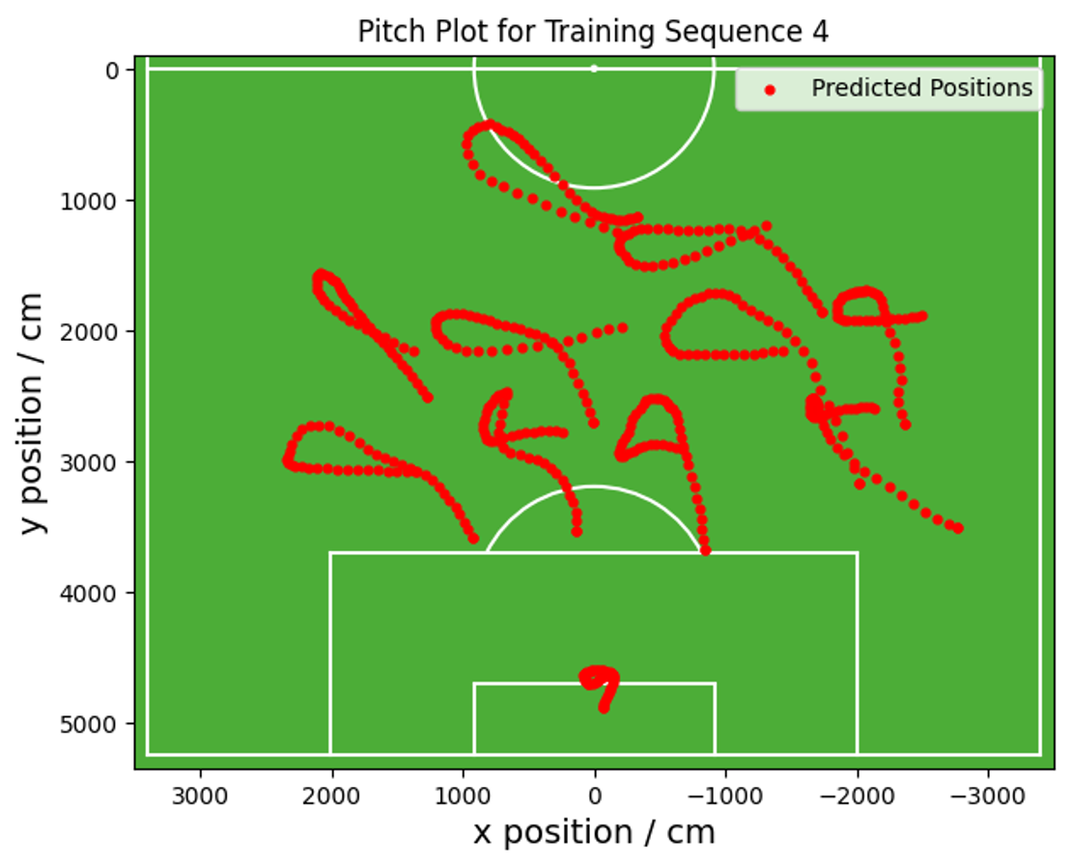
The Dataset
Included every team with below 45% possession between 2015-2021
Notes:
As aim of project was to simulate how a specific team defends
Perhaps the size of the dataset was too small
Mention train/test split
Access to a large amount of data so included every team under an arbitrary threshold
30,000 sequences across 7 seasons -> model should be able to learn more patterns from more data
However, using more teams made the dataset much noisier

Slide 8
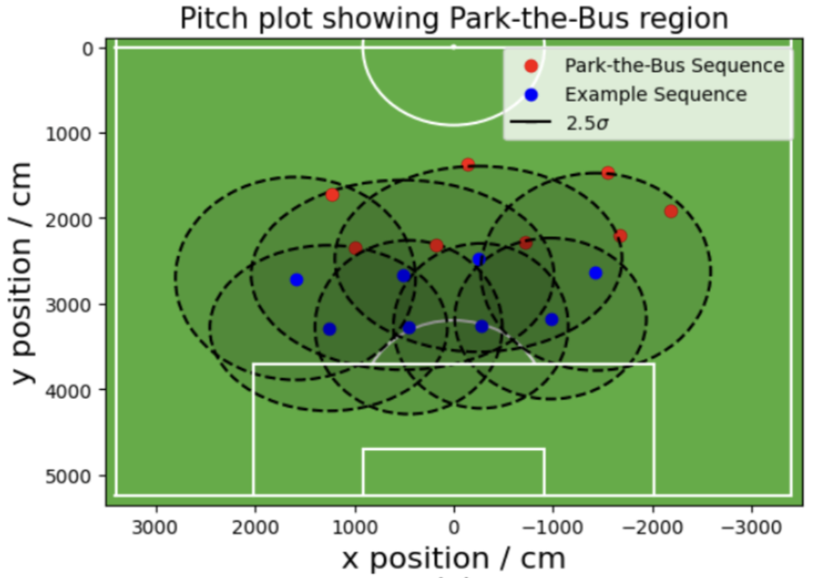
The Dataset
Park-the-Bus Filter
Example Sequence
Park-the-Bus Sequence
Park-the-Bus difficult to define
Notes:
Increasing dataset to include multiple teams made it very noisy
Despite teams having similar possession stats, they play different styles

Slide 9
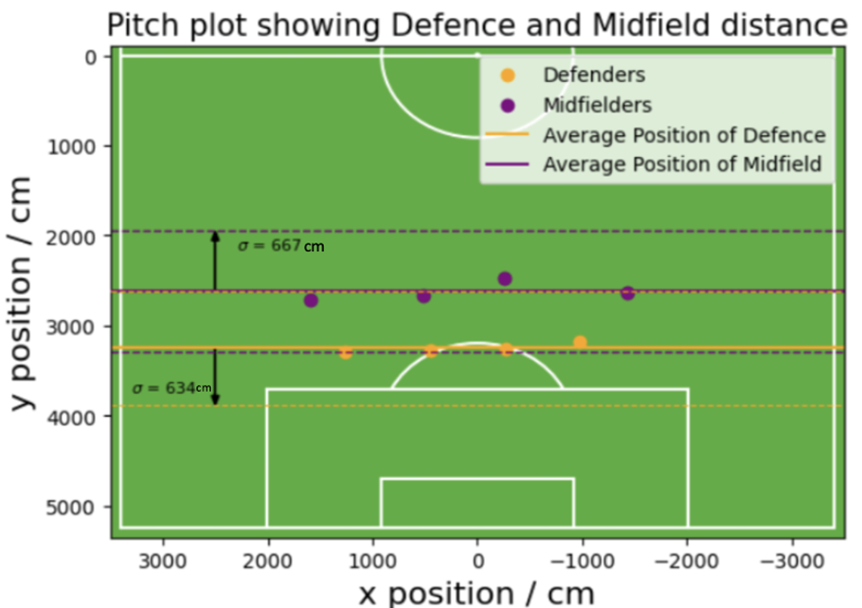
The Dataset
Park-the-Bus Filter
Example Sequence
Park-the-Bus Sequence
Park-the-Bus difficult to define
Notes:
Increasing dataset to include multiple teams made it very noisy
Despite teams having similar possession stats, they play different styles

Slide 10
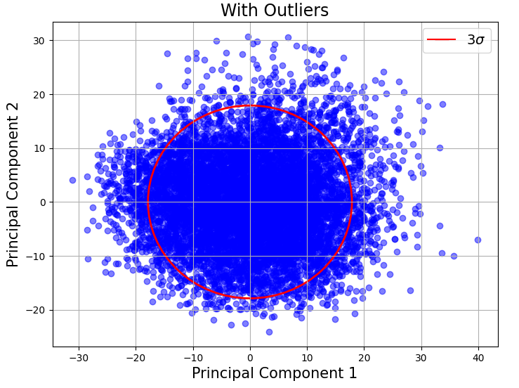
The Dataset
Park-the-Bus Filter
Example Sequence
Park-the-Bus Sequence
Park-the-Bus difficult to define
Notes:
Increasing dataset to include multiple teams made it very noisy
Despite teams having similar possession stats, they play different styles

Slide 11
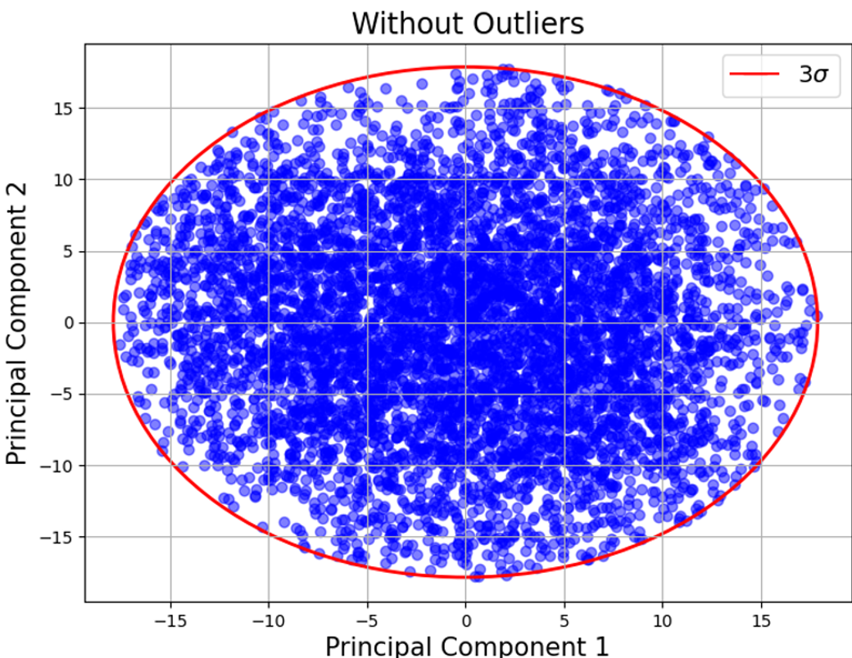
The Dataset
Park-the-Bus Filter
Example Sequence
Park-the-Bus Sequence
Park-the-Bus difficult to define
Notes:
Increasing dataset to include multiple teams made it very noisy
Despite teams having similar possession stats, they play different styles

Slide 12
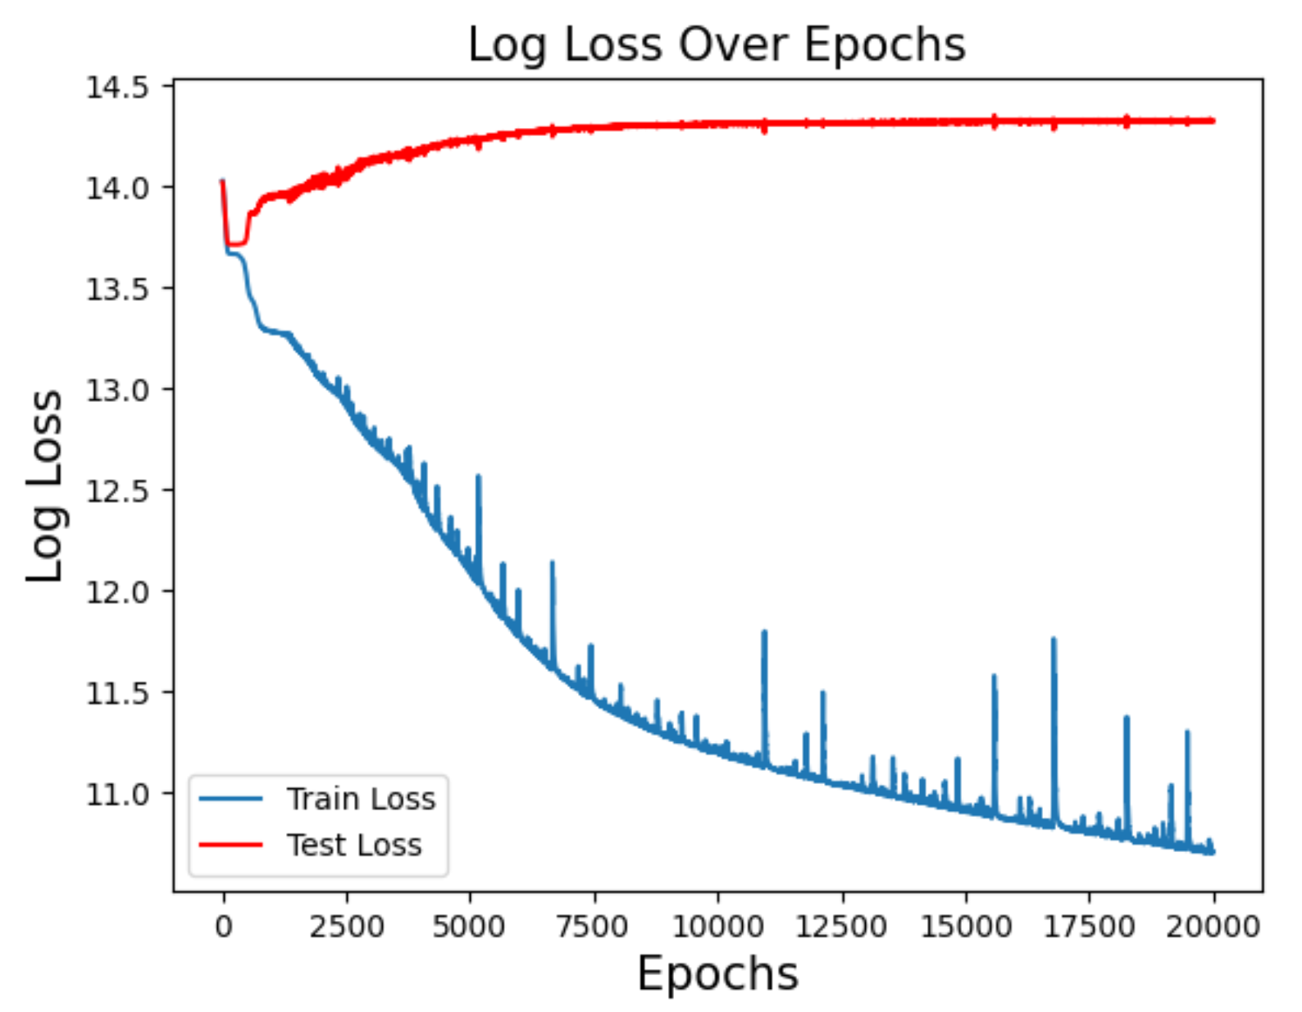
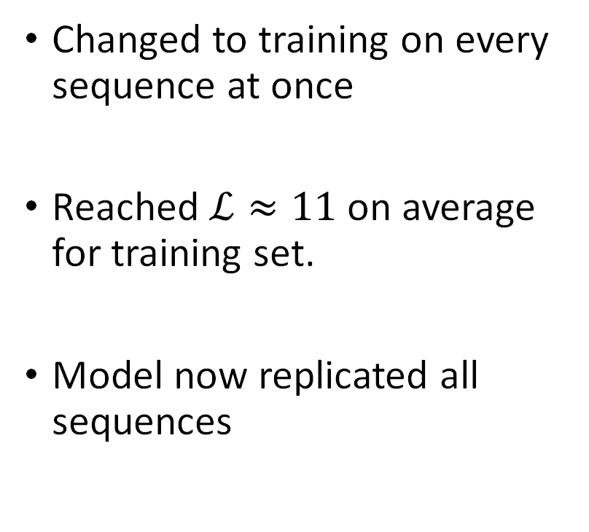
Training On Sequences
Changed to training on every sequence at once
Reached $ℒ≈11$ on average for training set.
Model now replicated all sequences

Slide 13
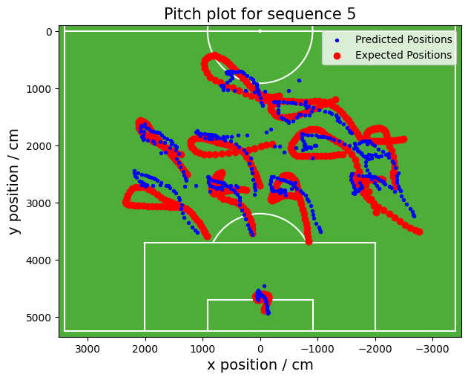
Training On Sequences
Changed to training on every sequence at once
Reached $ℒ≈11$ on average for training set.
Model now replicated all sequences

Slide 14
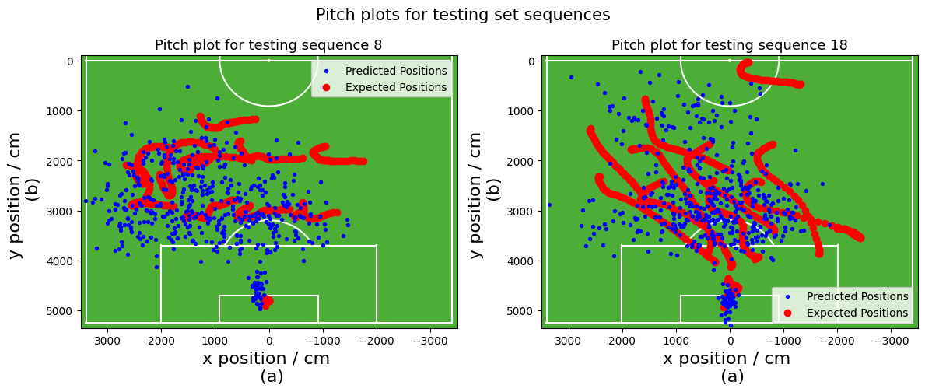
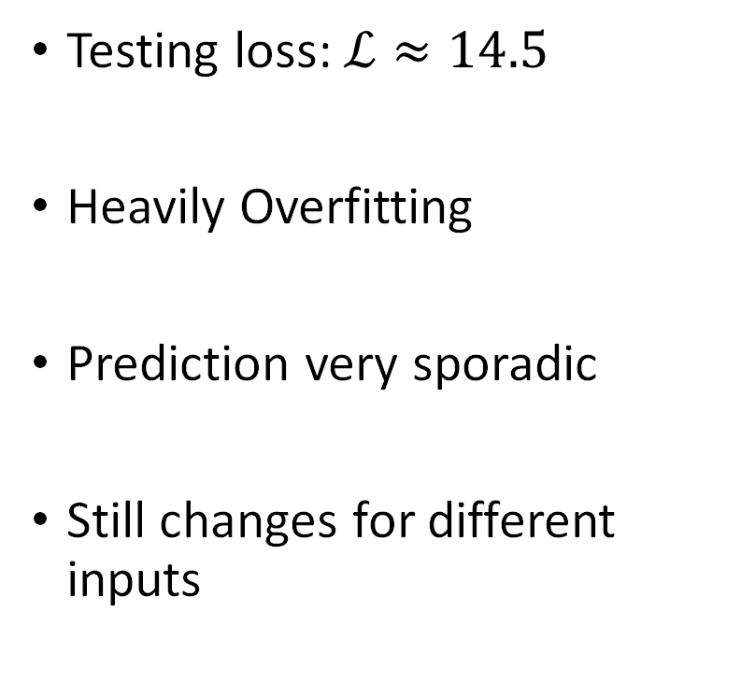
Testing Loss
Testing loss: $ℒ≈14.5$
Heavily Overfitting
Prediction very sporadic
Still changes for different inputs

Slide 15
Testing Loss
Testing loss: $ℒ≈14.5$
Heavily Overfitting
Prediction very sporadic
Still changes for different inputs

Slide 16
Simplifying the Problem
Get the model to predict individual frames
Changed to a regular Neural Network

Slide 17
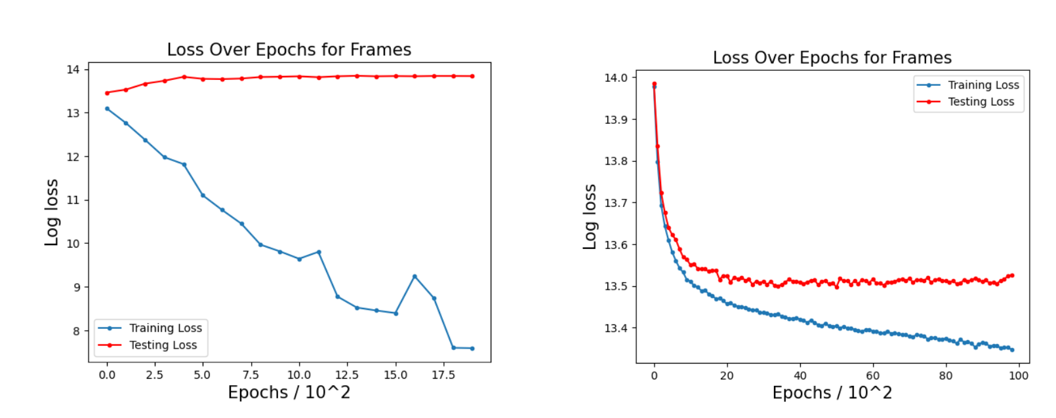
Simplifying the Problem to Frames
Loss

Slide 18
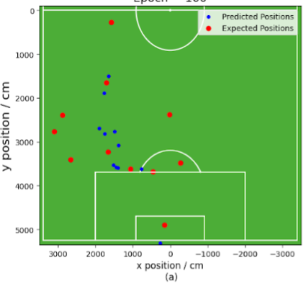

Unseen Frames Pitch Plots
$$ℒ_{test} ≈14.2$$

Slide 19
Convolutional Neural Network
Solve input inconsistencies
Convolutional layer for input
Input Vector:
$$I^{68×105}$$

Slide 20
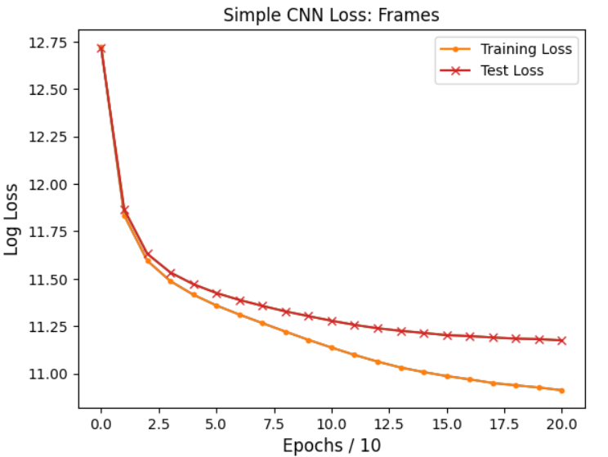
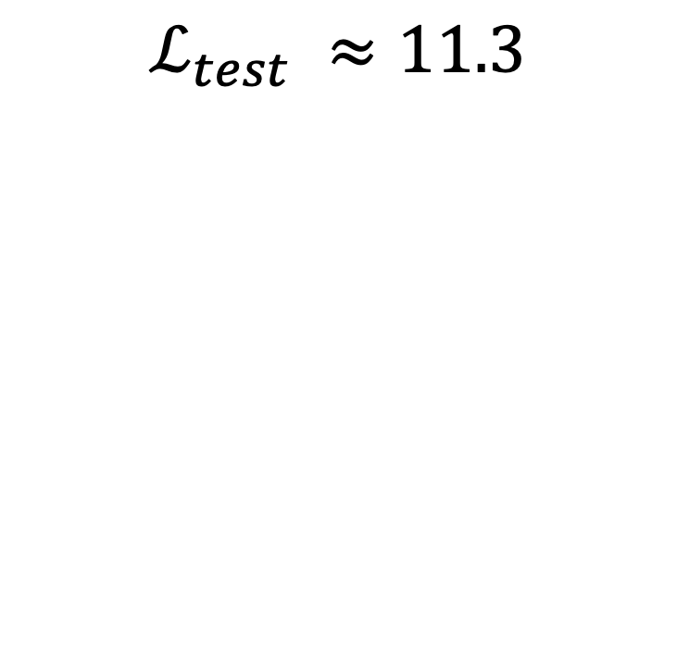
Singular Frames
New method
Log Loss:
Avg error:
$$ℒ_{test} ≈11.3$$

Slide 21
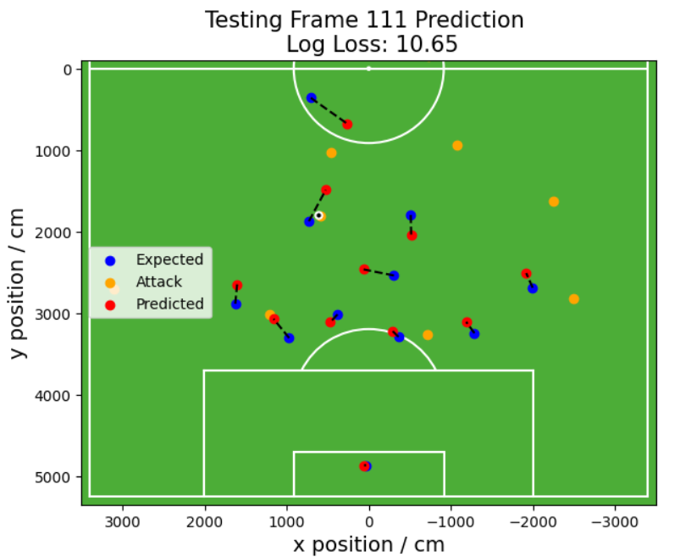
Unseen Frames Pitch Plots
New method

Slide 22
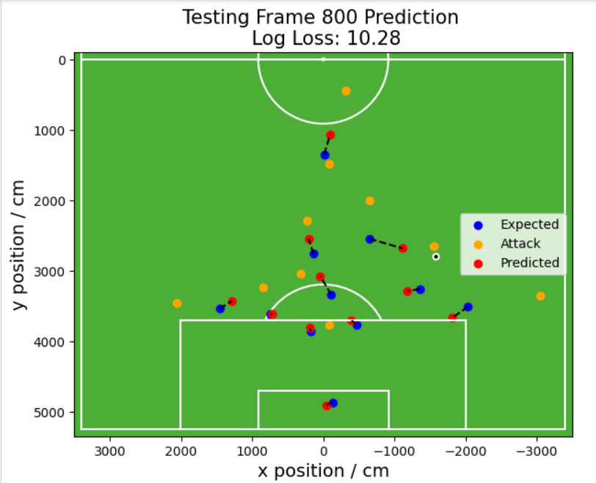
Unseen Frames Pitch Plots
New method

Slide 23
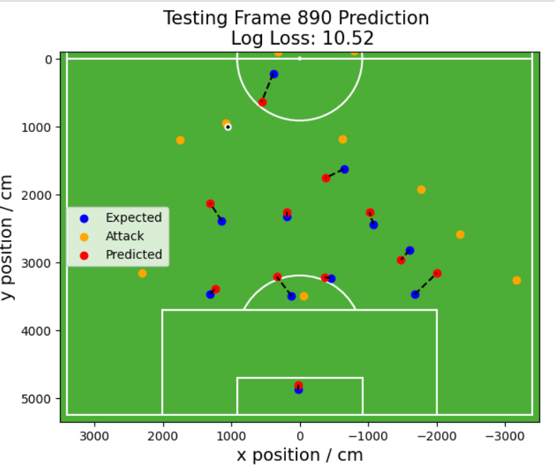
Unseen Frames Pitch Plots
New method

Slide 24
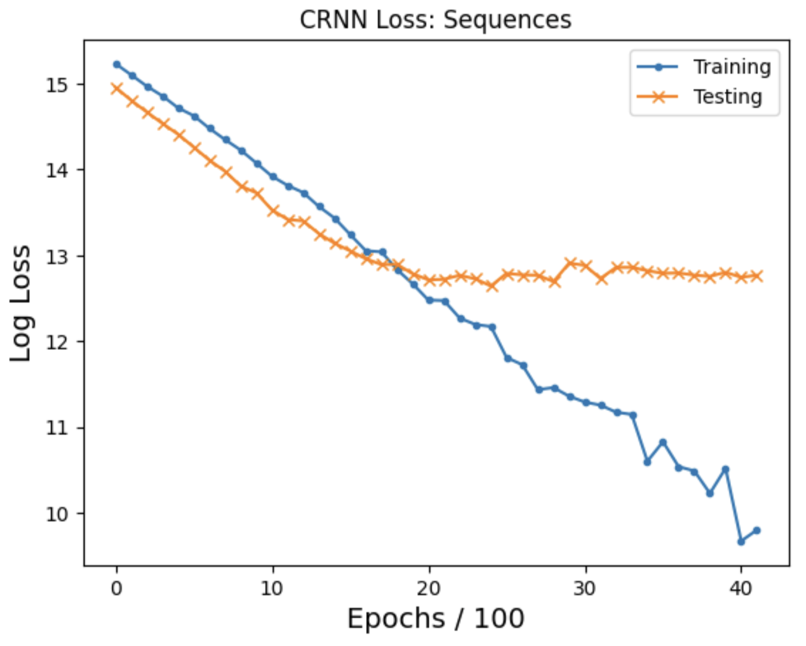
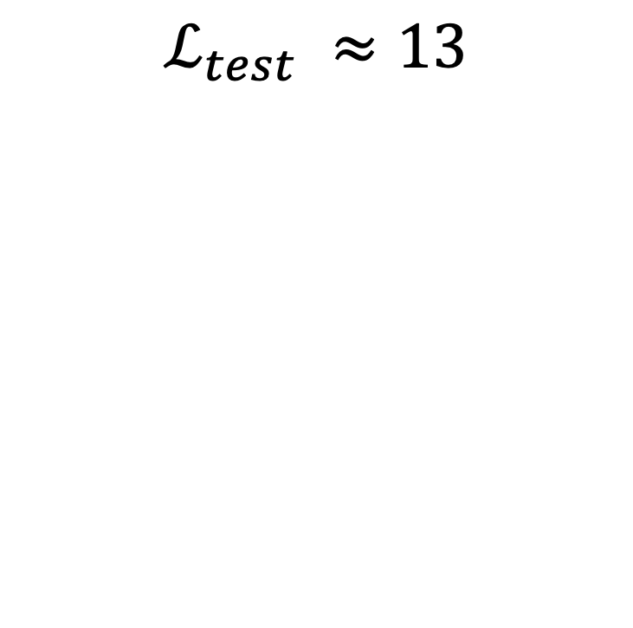
Sequences: CRNN
$$ℒ_{test} ≈13$$

